Slide 1
Review for Exam 2
Some important themes from Chapters 6-9
Chap. 6. Significance Tests
Chap. 7: Comparing Two Groups
Chap. 8: Contingency Tables (Categorical variables)
Chap. 9: Regression and Correlation (Quantitative var’s)

Slide 2
6. Statistical Inference: Significance Tests
A significance test uses data to summarize evidence about a hypothesis by comparing sample estimates of parameters to values predicted by the hypothesis.
We answer a question such as, “If the hypothesis were true, would it be unlikely to get estimates such as we obtained?”
.

Slide 3
Five Parts of a Significance Test
Assumptions about type of data (quantitative, categorical), sampling method (random), population distribution (binary, normal), sample size (large?)
Hypotheses:
Null hypothesis (H₀): A statement that parameter(s) take specific value(s) (Often: “no effect”)
Alternative hypothesis (H_{a}): states that parameter value(s) in some alternative range of values

Slide 4
Test Statistic: Compares data to what null hypo. H₀ predicts, often by finding the number of standard errors between sample estimate and H₀ value of parameter
P-value (P): A probability measure of evidence about H₀, giving the probability (under presumption that H₀ true) that the test statistic equals observed value or value even more extreme in direction predicted by H_{a}.
  The smaller the P-value, the stronger the evidence against H_{0.}
Conclusion:
  If no decision needed, report and interpret P-value

Slide 5
  If decision needed, select a cutoff point (such as 0.05 or 0.01) and reject H₀ if P-value ≤ that value
  The most widely accepted minimum level is 0.05, and the test is said to be significant at the .05 level if the P-value ≤ 0.05.
  If the P-value is not sufficiently small, we fail to reject H₀ (not necessarily true, but plausible). We should not say “Accept H₀”
  The cutoff point, also called the significance level of the test, is also the prob. of Type I error – i.e., if null true, the probability we will incorrectly reject it.
  Can’t make significance level too small, because then run risk that P(Type II error) = P(do not reject null) when it is false is too large

Slide 6
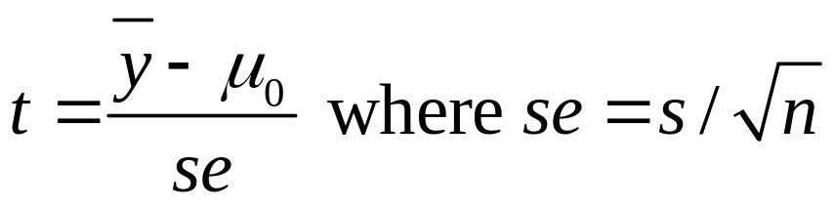
Significance Test for Mean
Assumptions: Randomization, quantitative variable, normal population distribution
Null Hypothesis: H₀: µ = µ₀ where µ₀ is particular value for population mean (typically no effect or change from standard)
Alternative Hypothesis: H_{a}: µ ≠ µ₀ (2-sided alternative includes both > and <, test then robust), or one-sided
Test Statistic: The number of standard errors the sample mean falls from the H₀ value

Slide 7
Significance Test for a Proportion 
Assumptions:
  Categorical variable
  Randomization
  Large sample (but two-sided test is robust for nearly all n)
Hypotheses:
  Null hypothesis: H₀: π = π₀
  Alternative hypothesis: H_{a}: π ≠ π₀ (2-sided)
  H_{a}: π > π₀ H_{a}: π < π₀ (1-sided)
  (choose before getting the data)

Slide 8
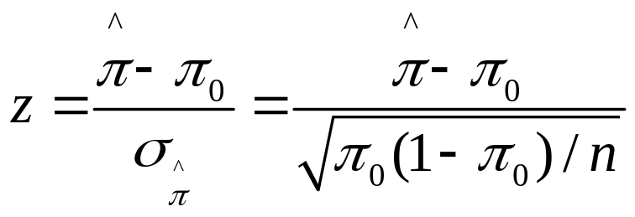
Test statistic:
Note
As in test for mean, test statistic has form
(estimate of parameter – null value)/(standard error)
= no. of standard errors estimate falls from null value
P-value:
  H_{a}: π ≠ π₀ P = 2-tail prob. from standard normal dist.
  H_{a}: π > π₀ P = right-tail prob. from standard normal dist.
  H_{a}: π < π₀ P = left-tail prob. from standard normal dist.
Conclusion: As in test for mean (e.g., reject H₀ if P-value ≤ )

Slide 9
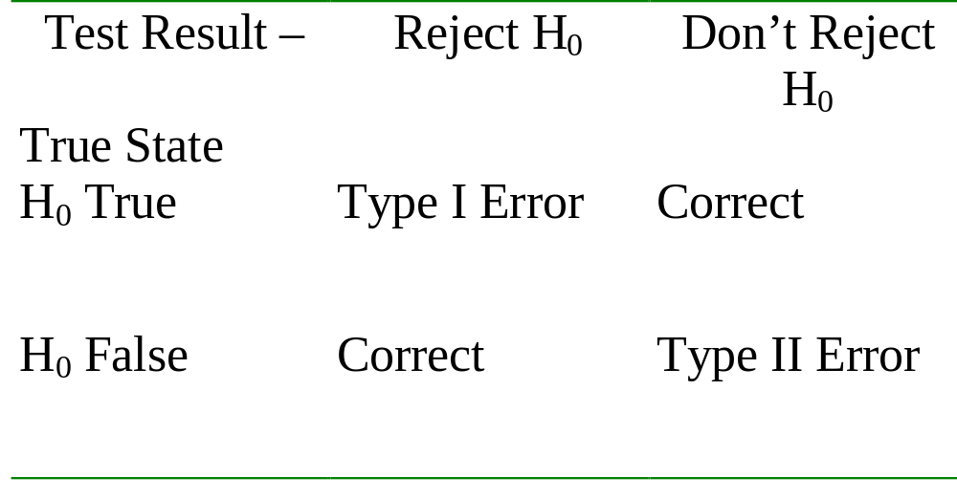
Error Types
Type I Error: Reject H₀ when it is true
Type II Error: Do not reject H₀ when it is false

Slide 10
Limitations of significance tests
Statistical significance does not mean practical significance
Significance tests don’t tell us about the size of the effect (like a CI does)
Some tests may be “statistically significant” just by chance (and some journals only report “significant” results)

Slide 11
Chap. 7. Comparing Two Groups
Distinguish between response and explanatory variables, independent and dependent samples
Comparing means is bivariate method with quantitative response variable, categorical (binary) explanatory variable
Comparing proportions is bivariate method with categorical response variable, categorical (binary) explanatory variable

Slide 12
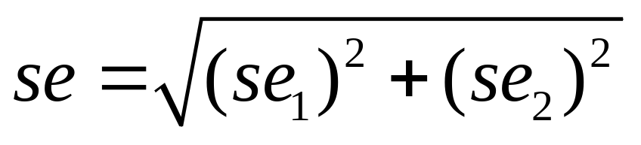
se for difference between two estimates (independent samples)
The sampling distribution of the difference between two estimates (two sample proportions or two sample means) is approximately normal (large n₁ and n_{2,} by CLT) and has estimated

Slide 13
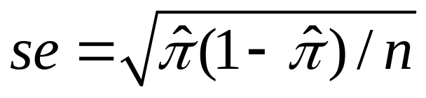
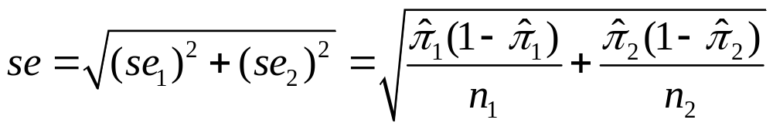
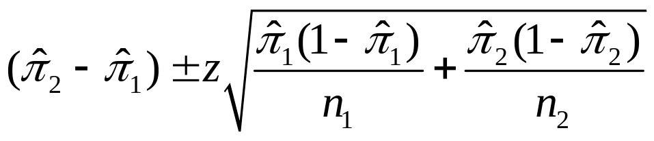
CI comparing two proportions
Recall se for a sample proportion used in a CI is
So, the se for the difference between sample proportions for two independent samples is
A CI for the difference between population proportions is
(as usual, z depends on confidence level, 1.96 for 95% conf.)

Slide 14
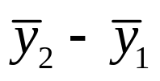
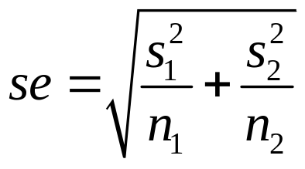
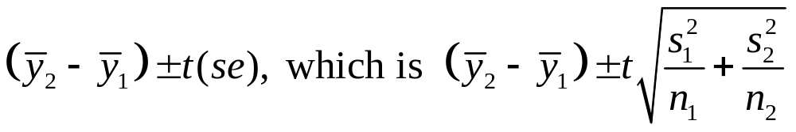
Quantitative Responses:
Comparing Means
Parameter: μ₂-μ₁
Estimator:
Estimated standard error:
  Sampling dist.: Approx. normal (large n’s, by CLT), get approx. t dist. when substitute estimated std. error in t stat.
  CI for independent random samples from two normal population distributions has form
  Alternative approach assumes equal variability for the two groups, is special case of ANOVA for comparing means in Chapter 12

Slide 15
Comments about CIs for difference between two parameters
When 0 is not in the CI, can conclude that one population parameter is higher than the other.
(e.g., if all positive values when take Group 2 – Group 1, then conclude parameter is higher for Group 2 than Group 1)
When 0 is in the CI, it is plausible that the population parameters are identical.
Example: Suppose 95% CI for difference in population proportion between Group 2 and Group 1 is (-0.01, 0.03)
Then we can be 95% confident that the population proportion was between about 0.01 smaller and 0.03 larger for Group 2 than for Group 1.

Slide 16

Comparing Means with Dependent Samples
Setting: Each sample has the same subjects (as in longitudinal studies or crossover studies) or matched pairs of subjects
Data: y_{i} = difference in scores for subject (pair) i
Treat data as single sample of difference scores, with sample mean and sample standard deviation s_{d} and parameter μ_{d} = population mean difference score which equals difference of population means.

Slide 17
Chap. 8. Association between Categorical Variables
Statistical analyses for when both response and explanatory variables are categorical.
Statistical independence (no association): Population conditional distributions on one variable the same for all categories of the other variable
Statistical dependence (association): Population conditional distributions are not all identical

Slide 18
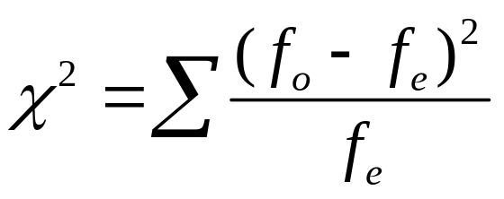
Chi-Squared Test of Independence (Karl Pearson, 1900)
Tests H₀: variables are statistically independent
H_{a}: variables are statistically dependent
Summarize closeness of observed cell counts {f_{o}} and expected frequencies {f_{e}} by
with sum taken over all cells in table.
Has chi-squared distribution with df = (r-1)(c-1)

Slide 19
For 2-by-2 tables, chi-squared test of independence (df = 1) is equivalent to testing H₀: ₁ = ₂ for comparing two population proportions.
Proportion
Population Response 1 Response 2
1 ₁ 1 - ₁
2 ₂ 1 - ₂
H₀: ₁ = ₂ equivalent to
H₀: response independent of population
Then, chi-squared statistic (df = 1) is square of z test statistic,
z = (difference between sample proportions)/se₀.

Slide 20
Residuals:
Detecting Patterns of Association
Large chi-squared implies strong evidence of association but does not tell us about nature of assoc. We can investigate this by finding the standardized residual in each cell of the contingency table,
z = (f_{o} - f_{e})/se,
Measures number of standard errors that (f_{o}-f_{e}) falls from value of 0 expected when H₀ true.
Informally inspect, with values larger than about 3 in absolute value giving evidence of more (positive residual) or fewer (negative residual) subjects in that cell than predicted by independence.

Slide 21
Measures of Association
Chi-squared test answers “Is there an association?”
Standardized residuals answer “How do data differ from what independence predicts?”
We answer “How strong is the association?” using a measure of the strength of association, such as the difference of proportions, the relative risk = ratio of proportions, and the odds ratio, which is the ratio of odds, where
odds = probability/(1 – probability)

Slide 22
Limitations of the chi-squared test
The chi-squared test merely analyzes the extent of evidence that there is an association (through the P-value of the test)
Does not tell us the nature of the association (standardized residuals are useful for this)
Does not tell us the strength of association. (e.g., a large chi-squared test statistic and small P-value indicates strong evidence of assoc. but not necessarily a strong association.)

Slide 23

Ch. 9. Linear Regression and Correlation
Data: y – a quantitative response variable
x – a quantitative explanatory variable
We consider:
Is there an association? (test of independence using slope)
How strong is the association? (uses correlation r and r²)
How can we predict y using x? (estimate a regression equation)
  Linear regression equation E(y) = α + β x describes how mean of conditional distribution of y changes as x changes
  Least squares estimates this and provides a sample prediction equation

Slide 24
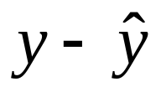

The linear regression equation E(y) =  +  x is part of a model. The model has another parameter σ that describes the variability of the conditional distributions; that is, the variability of y values for all subjects having the same x-value.
For an observation, difference between observed value of y and predicted value of y,
is a residual (vertical distance on scatterplot)
Least squares method minimizes the sum of squared residuals (errors), which is SSE used also in r² and the estimate s of conditional standard deviation of y

Slide 25
Measuring association: The correlation and its square
  The correlation is a standardized slope that does not depend on units
  Correlation r relates to slope b of prediction equation by
r = b(s_{x}/s_{y})
-1 ≤ r ≤ +1, with r having same sign as b and r = 1 or -1 when all sample points fall exactly on prediction line, so r describes strength of linear association
The larger the absolute value, the stronger the association
Correlation implies that predictions regress toward the mean

Slide 26
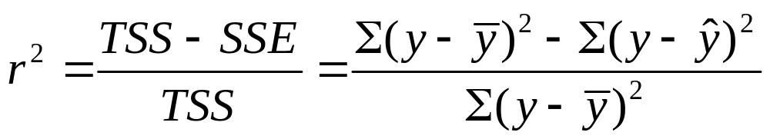
The proportional reduction in error in using x to predict y (via the prediction equation) instead of using sample mean of y to predict y is
Since -1 ≤ r ≤ +1, 0 ≤ r² ≤ 1, and r² = 1 when all sample points fall exactly on prediction line
r and r² do not depend on units, or distinction between x, y
The r and r² values tend to weaken when we observe x only over a restricted range, and they can also be highly influenced by outliers.

Slide 27
Inference: Based on linear regression model and its assumptions.
t distribution with df = n-2 for tests and CI’s about population slope  in E(y) =  +  x.
Test of  = 0 uses t = b/se, has corresponding t test for correlation.
t test is analog of chi-squared test for categorical variables; i.e., the null of  = 0 is an independence hypothesis.

Slide 28
Questions you should be able to answer
How do you interpret a P-value in terms of evidence about a null hypothesis?
How do you interpret a P-value as a probability of “more extreme” test statistic values under a presumption about a null hypothesis?
What are the two types of errors that can occur in a significance test? Definitions?
How do we control P(Type I error)?
Why is there not just one P(Type II error), and how does the value depend on how far the parameter falls from the null hypothesis value?

Slide 29
What’s the binomial distribution used for?
For comparing two means or comparing two proportions, give an example of (a) independent samples, (b) dependent samples.
Give an example of (a) response var., (b) categorical explanatory var., and identify whether response is quantitative or categorical and state the appropriate analyses.
For estimating the difference between two parameters by the difference between two statistics with independent samples, how do we get the se from the se values of the individual statistics?
How do we interpret a CI for a difference between two means (proportions)?
How do we analyze dependent samples for comparing two groups on a quantitative response variable?

Slide 30
What does “statistical independence” mean for two categorical variables? Give example of population conditional distributions that show:
Statistical independence between variables
Association between variables, but weak (strong)
For 2x2 tables, what is the chi-squared test doing that relates to analyses for comparing two groups?
In what sense does Pearson’s chi-squared statistic (or any test statistic in a significance test) measure statistical significance but not practical significance?
A standardized residual in a cell in a contingency table equals ( a) -3.0, (b) -0.3. What does this mean?

Slide 31
What do we mean by a linear regression model?
What is a residual, and how do residuals relate to summarizing regression prediction errors, “least squares” estimates, r-squared?
What is the effect of units of measurement on least squares prediction equation, correlation, inferences such as t test about slope? What’s effect of interchanging x and y?
In what sense is the correlation a standardized slope? How can you interpret it in this way, how can you interpret it in terms of the effect of a standard deviation change in x, and how can you interpret the square of its value?

Slide 32
What is meant by “regression toward the mean” and what are some of its implications? (What would have to happen for there to be no regression toward the mean?)
When is the correlation misleading as a measure of association for quantitative variables? Why?
What is meant by a “conditional distribution” (quantitative, categorical cases)? What is a “conditional” standard deviation and when is it much less than a “marginal” standard deviation?
How do you do a test of independence for (a) two quantitative variables? (b) two categorical variables? (c) a quantitative and a categorical variable (that is binary)?

Slide 33
If for a given data set, predictor x₁ has a stronger correlation with y than does x₂ then how do their SSE values compare? TSS values?
Be able to interpret regression output for
comparing two means
cross-classifying two categorical variables
regression and correlation analysis

